Slide 1
Empathic approaches to research support in pressured times
Notes:
(Allow for approx. 3 minutes):
This session is an opportunity to explore common challenges and find positive solutions together. Even if you walk away with just one idea, or feel a bit better about something that’s been bothering you, we hope that will be a sign that you’ve found this session useful. You'll see from the agenda that there will be an opportunity to get some frustrations off your chest but we hope that the session will be constructive and that you'll have some new strategies or tactics to try out after today.
Please include a short introduction/biography about you here, followed by your reasoning/rationale for wanting to run this session.
Please also feel free to alter the background, which has been purposely left blank for you to tailor to your institution.
This session was originally put together by Dr Tania Cleaves (University of Birmingham) and Dr Liese Perrin (previously University of Birmingham [2018-2021], presently Coventry University [2021 – Present]). Please feel free to get in contact with Tania for any questions or comments at T.A.Cleaves@bham.ac.uk.

Slide 2
AGENDA
Introductions
Activity 1: Identify your triggers
Comfort break
Activity 2: Sharing best practice
Presenters’ tips
Concluding remarks and Q&A
Notes:
(Allow 1 minute for this slide):
Today's agenda includes spending short periods on particular tasks – they are a mix of self-reflective activities, group breakout opportunities, and time together as a group for discussion and questions. We will try to stay as close as possible to this schedule but are also very flexible and open-minded on what you feel you need out of the session too.
Our suggested timetable for a 2-hr session is as follows, but if you choose to run this during a shorter time frame, please reduce correspondingly:
Introductions – allow c.10-15 minutes to introduce yourself, go through the agenda and present opening slides
Activity 1 (a. self-reflective): identify your triggers – allow c.5 minutes
Activity 1 (b. breakout session): small group discussion of triggers – allow c.20 minutes
Activity 1 (c. full group discussion): discussion and Q&A – allow c.15 minutes
Comfort break, if appropriate – allow c.5 minutes
Activity 2 (a. breakout sessions): sharing best practice around key triggers (e.g. time, communication and respect) – allow c.20 minutes
Activity 2 (b. full group discussion): discussion – allow c.20 minutes
Presenters’ tips – allow c.10 minutes
Concluding remarks and Q&A – allow c.10 minutes

Slide 3
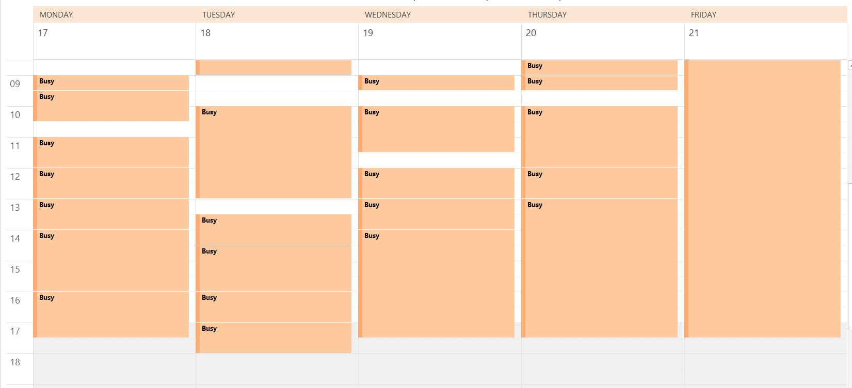
A week in the life of a senior academic…
Notes:
(Allow 2-3 minutes for this slide, and feel free to insert your own example here instead of using this one)
We want to begin by highlighting the pressures academics are under around teaching and marking, attending endless meetings, publishing for REF, travelling for research and dissemination, writing grant applications, being available at all hours to answer emails, and climbing the career ladder. This was originally a snapshot of a senior academic in 2019. Imagine how much more pressured this has become around remote teaching and blended approaches (which for some has doubled workload for teaching). This example we’re showing is useful to keep in mind when you’re chasing that glowing letter of support from a Head of Dept/School/Faculty… When academics say they are busy, they are BUSY!
Another point to make is that periods of teaching, marking and exams rarely fit nicely with our own world of Professional Services: funding deadlines, for instance, can clash horribly with peak teaching periods, and so can they clash with our personal lives (e.g. caring responsibilities).

Slide 4

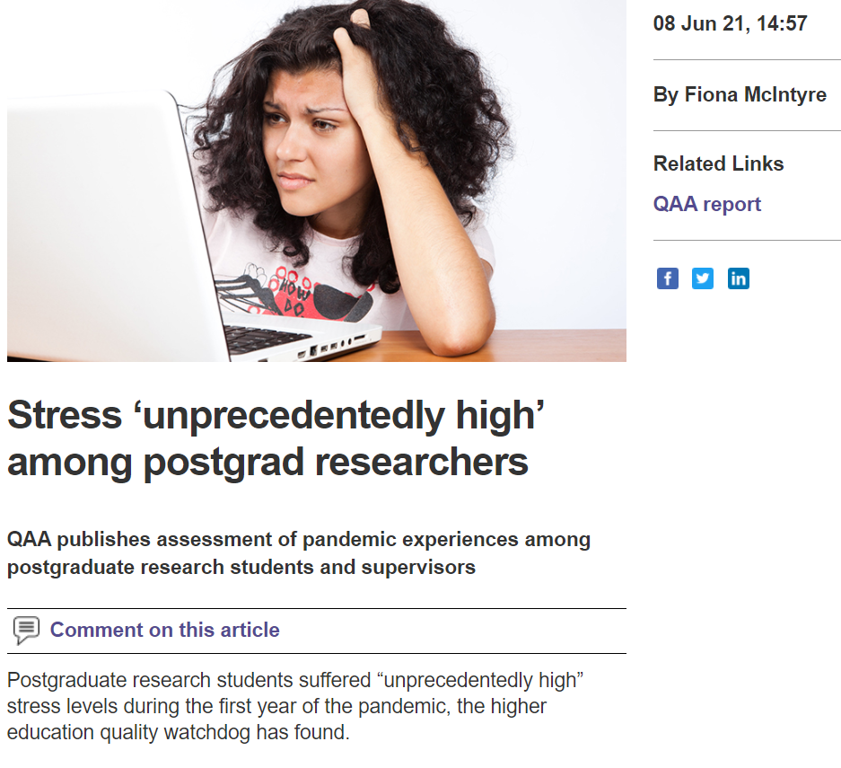
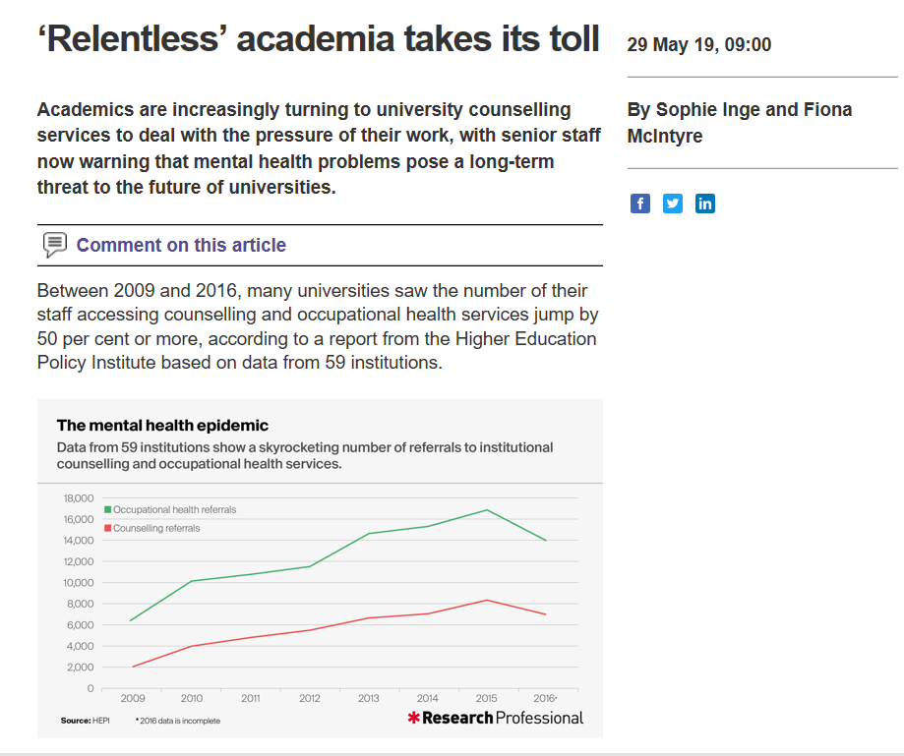
https://www.hepi.ac.uk/wp-content/uploads/2019/05/HEPI-Pressure-Vessels-Occasional-Paper-20.pdf
Notes:
(Allow 1-2 minutes for this slide, and see also/use instead data from the following: https://www.vitae.ac.uk/vitae-publications/the%20impact%20of%20the-covid-19-pandemic-on-researchers-and-research?utm_medium=email&utm_source=govdelivery )
Empathising with academics builds instant rapport, understanding and trust. But that doesn't mean the job is always easy or pleasant, or that we don't regularly encounter difficult situations or people.
It’s easy to find studies on the stress levels and increasing uncertainty of the academic lifestyle, but as members of Professional Services within HEIs supporting them, it can feel as though our own increasing pressures are overshadowed, rendered invisible.
This has only been exacerbated by the pandemic, and while there have been many benefits to remote working, there have equally been real struggles. And therefore...

Slide 5
'Everyone you meet is fighting a battle you know nothing about. Be kind. ALWAYS.'
- Robin Williams

Slide 6
At the same time, we’re also facing:
Shorter deadlines
Increasing requirements for demand management
Increasing targets
Increasing requirements for ethics and governance processes
Greater levels of competition
Larger, more complex applications
Cuts to Professional Services in Universities and at funders
Notes:
Allow 1-2 minutes for this slide and add/amend if you wish:
We’ve got a lot on our plate these days. Just when we thought the list of challenges on the slide was bad enough, the pandemic hit and we were dealing with recruitment freezes, swathes of grant extension requests, the REF deadline being extended, huge uncertainty (and then chaos) over student recruitment, cuts to ODA funding and that was on top of remote working, homeschooling, illness and missing family and friends.
And that's why we wanted to run this session. Obviously we can't fix everything you're facing (or the sector or society in general is facing!) in this short session, so we'll have to take a representative number of broad scenarios and focus on these. We'd like to do this through two activities:

Slide 7
Activity 1: Identify your triggers
Spend five minutes on your own, thinking through a) the main issue(s) or source(s) of stress in your role. Write it down.
b) Why is it bothering you?
c) What needs to change to find a way forward here? What’s the ideal resolution?
Spend the next 20 minutes, as a group, firstly for each person to introduce themselves and read out what they wrote, without interruption; secondly, discussing these trigger points; and thirdly, putting these up on Jamboard.
Notes:
FIRST TO SAY: CHATHAM HOUSE RULES, THIS IS A SAFE SPACE WITH NO JUDGEMENT; if you are comfortable sharing your contact details, we find these conversations may continue and evolve off-line and act as a springboard for implementing new techniques in one’s institution and to network with each other.
1) TRIGGERS
Think of what pulled you here, to this session.
An example: My pet peeve is last-minute bidders who don't seem to respect or appreciate what's involved in putting in an application - for them, for us, or others like senior management. They essentially jump the queue in front of others we have been focusing on.
Why does this bother me? Because I am a planner, hate uncertainty, and believe in fairness. In other words, the issue doesn’t align with my values.
What needs to change? Perhaps better communication strategies internally around expectations and lead times.
Another example: My pet peeve is one that has worsened with the pandemic and that is the tension between research and teaching and being caught in the middle of PIs and Heads of School who disagree on buy-out and time commitments on research projects.
Why does this bother me? Because it pits people against each other when they should all be pulling in the same direction and generates misinformation, mistrust and bad feeling around grants.
What needs to change? We need to build in time for adequate discussion, time to explore possible solutions and we probably need to educate people about how staff time/replacement teaching works. And we definitely need more transparency around how we approach this as an institution.
Activity 1: Identify your trigger (5 min self-reflexive activity)
Breakout activity 1 (20 min) - Move to breakout room to discuss triggers, using Jamboard or similar to put up anonymised post-it responses and share
Back together to go through these (15 min), with time for Q&A
The above presumes you are delivering this online vs in-person, so that questions can be put in the Chat function, which you can also read out. Or you can use the ‘raise hand’ function within Zoom
Go through the Jamboard (if using) to read these. Does anyone have reflections or questions; does any of this resonate for you?
AIRING ZONE
Followed by COMFORT BREAK FOR 5 MIN

Slide 8
Activity 2: Sharing best practice
Can you offer concrete, practical tips for any of these?
1. TIME – ‘I have a heavy workload, so struggle to offer in-depth support and then also have to contend with last-minute requests for help, against tight deadlines.’
2. COMMUNICATION – ‘I’m exhausted writing the same info in emails and people just coming back with more questions.’ (e.g. applicants, project partners, internal colleagues)
3. RESPECT – ‘I give applicants advice but they don’t listen to me! We’re trying to help improve quality and they don’t appreciate my expertise.’
Notes:
2) SHARING BEST PRACTICE (breakout groups, allow 20 minutes)
In the second part of this presentation, let’s brainstorm through strategies that might help. We know we can’t solve every problem, but we’d like for you to discover at least one useful tool or idea that might be helpful, something positive to take away from this event. We all need constructive and practical advice.
So let’s cover a broad range of potential issues, and we’ll be here to write down your tips via Jamboard. See how many tips you can offer.
Breakout group 1, begins with TIME
Breakout group 2, begins with COMMUNICATION
Breakout group 3, begins with RESPECT
(Flexible if only small turnout, if only one group they can discuss all three topics/areas. There may also be other key issues flagged during Activity 1, which you could add to here [during Comfort Break, perhaps])
List these on Jamboard, if using; please try to be as clear and precise as possible as a resource afterwards for all with targeted ideas.
Back together to go through these (20 min), with time for Q&A
Of these offerings, do any of these work for you; will you take any of these away to implement, or have you implemented any of these in practice and have advice; do you have any questions about them? These conversations can continue offline through exchanging contact details, for instance.
Some of ours are on the next slide…

Slide 9
Our top tips:
Signpost academics to your Research Support webpages, for e.g. Funding Opportunities, Resources, to cultivate self-service
Cross-check applications before academics hit submit: this irons out final issues and means that the final institutional acceptance/approval stage becomes quick and painless
Produce documents/guides to help academics plan and budget their projects, pre-application
Provide tips on popular schemes, so as to avoid writing repetitive emails to multiple applicants (as a pdf; or draft emails to copy/paste text)
Create timetables sent to academics to set expectations / manage workload in the office
For open call schemes, offer slots in the pipeline, which sets a social contract for the academic to work towards and keeps them motivated and invested
Establish a College-level Peer Review Group, drawn from UKRI and ERC reviewers, to supplement School and Research Office reviews
Plan a researcher development (training) programme including sessions covering popular funding schemes, tips for early-career researchers, collaborative grant-writing, etc.
Notes:
Allow 10 minutes to go through these, and please feel free to edit/amend/add as appropriate with your own experience and advice!)

Slide 10
Concluding remarks:
Empathy in the workplace has been shown to boost productivity, fuel effective collaboration, cultivate cultural awareness and respect, build leadership, and create trusting relationships. Empathy (and emotional intelligence in general) allows us to understand our own ways of thinking and working as well as others', ultimately producing better working relationships and higher job satisfaction.
Take stock of what you've already achieved, of examples where you have already demonstrated empathy in your role.
Try to remember that people behave and act poorly when under stress, and this affects their rational decision-making (and often their manners!).
We are not suggesting you lower your expectations or standards, but rather that you cultivate tolerance, acceptance and empathy to those people and situations you cannot reasonably change or control. In other words, recognise what is actually in your control, and what is not. If you can do something, go for it. But remember to maintain realistic expectations of your role and responsibilities.
Take the time for gratitude at the end of your working day, to acknowledge the positives. And be kind to yourself.
Notes:
Allow 10 minutes for this slide and any last Q&A

Slide 11
Independent coaching exercise, post-session:
Gill Windle, Institute of Medical Social Care of Bangor University (UK), describes resilience as ‘the process of negotiating, managing and adapting to significant sources of stress and trauma. Assets and resources within the individual, their life and environment facilitate the capacity for adaptation in the face of adversity. Across the life course, the experience of resilience will vary.’
What strengths (assets, resources) can I use to approach this problem - in yourself, in your team, Dept/School, Faculty/College and institutional level to help you find the solution to your problem?
What have you done in similar situations before?
What would someone you admire do in this situation?
Notes:
Optional follow-up/post-session activity:
Spend some time after this session, on your own, to focus on some questions to help you think through options for solving this issue – lines of enquiry that will help you build your own resilience to deal with this and other future challenges:
What strengths can I use to approach this problem? (If it’s hard to name your strengths, think what those close to you might say are your strengths). What strengths - assets and resources - do you have in yourself, in your team, Dept/School, Faculty/College and at institutional level to help you find the solution to your problem?
What have you done in similar situations before?
What would someone you admire do in this situation? (Often who and what we admire highlights our values and strengths too).

Slide 12
Resources
Liz Morrish, 'Pressure Vessels: the epidemic of poor mental health amongst HE staff,' HEPI 2019 report: https://www.hepi.ac.uk/wp-content/uploads/2019/05/HEPI-Pressure-Vessels-Occasional-Paper-20.pdf
Dano Moreno, '7 Benefits of Empathy in the Workplace', 2017, https://www.civcom.com/blog/7benefits
Robertson Cooper personal resilience self-assessment: https://www.robertsoncooper.com/iresilience/
Jung-Briggs Myers personality test (for you and your team!): http://www.humanmetrics.com/personality
Kathryn Jackson, Resilience at work, 2018.
Rick Hanson, Forrest Hanson, Resilient: how to grow an unshakeable core of calm, strength and happiness, 2018.
Monica Worline, Jane Dutton, Awakening Compassion at work, 2017.
Dan Lucy, Meysam Poorkavoos, Arun Thompson, Building Resilience: five key capabilities, Roffey Park, 2014.
Rick Brinkman, Rick Kirschner, Dealing with people you can't stand: how to bring out the best in people at their worst, various editions.
James Brooke, Simon Brooke, Be Bulletproof: how to achieve success in tough times at work, 2012.
Damon Zahariades, The Art of Saying NO: how to stand your ground, reclaim your time and energy, and refuse to be taken for granted (without feeling guilty!), 2017.
Cal Newport, Deep Work: rules for focused success in a distracted world, 2016.
Sam Leith, Write to the Point: how to be clear, correct and persuasive on the page, 2018.

